Slide 1
PIP2001 Capstone Project
Final Review
Project Title:Relative Attractiveness Index of World Markets
Batch Number: CSE55
Roll Number | Student Name
20211CSE0375 | K Layasree
20211CSE0270 | Uppara dhanalakshmi
20211CSE0304 | R.Snehalatha Reddy
20211CSE0815 | Y.Siva Reddy
Under the Supervision of,
Ms.Kalpana K
School of Computer Science and Engineering
Presidency University
Name of the Program: B.tech (Computer Science Engineering)
Name of the HoD: Dr.Asif Mohammed
Name of the Program Project Coordinator: Mr.Amarnath J L ( AP)
Name of the School Project Coordinators: Dr. Sampath A K / Dr. Abdul Khadar A / Mr. Md Ziaur Rahman

Slide 2
Introduction
A framework for making decisions, the Relative Attractiveness Index (RAI) assesses the potential for investment in international pharmaceutical markets. This index takes into account the competitive and dynamic nature of the pharmaceutical sector, where investment strategies are shaped by ongoing innovation, shifting market conditions, and regulatory changes. Investors are able to make well-informed, strategic decisions that maximize profits and minimize risks by utilizing the RAI, which gives them a thorough grasp of market dynamics.
By combining qualitative and quantitative elements, the RAI evaluates market attractiveness. In order to present a comprehensive picture of international markets, it looks at risk levels, regulatory frameworks, profitability, and growth prospects. Investors are able to spot good prospects while avoiding potential pitfalls thanks to this methodical approach. The RAI is a vital instrument for strategic decision-making in the pharmaceutical sector, since market conditions are frequently unstable and impacted by outside variables including healthcare regulations and economic trends.

Slide 3
Literature Review
Investment decisions in the dynamic and complicated pharmaceutical industry frequently necessitate in-depth examinations of the regulatory landscape, market dynamics, and innovation trends. One useful tool for directing these choices is the Relative Attractiveness Index (RAI). The accuracy, dependability, and relevance of current approaches must be improved, nevertheless, because they have serious drawbacks.
A survey of the body of research reveals a number of issues with conventional RAI approaches. Among these difficulties are:
Subjectivity in Factor weighing
Limited Attention to Emerging Trends
Problems with Data Availability and Quality
Generalization of Results
Complexity of Market Dynamics
Notes:
Literature Review Slide Content:
Title: Literature Review
Introduction:
The concept of the Relative Attractiveness Index (RAI) provides a framework for evaluating the attractiveness of investments across various markets, including the pharmaceutical sector.
The pharmaceutical industry presents unique challenges due to its reliance on R&D investments, regulatory hurdles, and long product lifecycles.
Key Research Findings:
US7882001: Graphical System for Determining Investment Attractiveness
Strengths: Multi-factor evaluation using financial and growth indicators.
Application in Pharma: Aids in comparing peer companies based on risk and growth metrics.
Drawbacks: Complexity in interpretation and reliance on quantitative data alone.
ssrn_id3540484: Modeling Investment Attractiveness Using Entropy
Strengths: Predicts market instability using mathematical measures.
Application in Pharma: Evaluates risk and stability in volatile market conditions like the COVID-19 pandemic.
Drawbacks: Primarily uses historical data; qualitative factors like regulation and innovation potential are not integrated.
Paper18: Comparative Analysis Pre/Post-COVID-19
Strengths: Combines statistical and fractal methods to assess financial instruments, including those in pharma.
Drawbacks: Limited inclusion of qualitative factors like drug pipelines and patents.
Pharma Quality (1-s2.0-S1319016413001114)
Strengths: Reviews global pharma quality standards and highlights quality management practices like Six Sigma.
Application: Highlights quality as a competitive advantage in pharma, important for attracting investment.
Drawbacks: Few case studies on real-world implementation.
Conclusion:
The literature on the Relative Attractiveness Index indicates its valuable role in evaluating pharmaceutical market investments by balancing quantitative and qualitative factors. However, methodologies like those using entropy analysis and fractal dynamics can benefit from incorporating more forward-looking factors like innovation potential and regulatory changes.

Slide 4
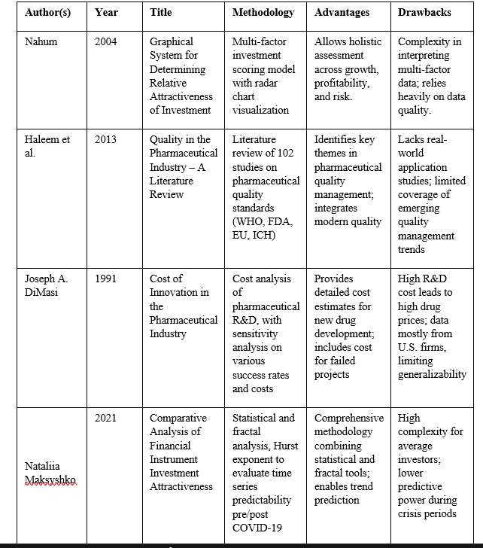
Literature Review
Notes:
Literature Review Slide Content:
Title: Literature Review
Introduction:
The concept of the Relative Attractiveness Index (RAI) provides a framework for evaluating the attractiveness of investments across various markets, including the pharmaceutical sector.
The pharmaceutical industry presents unique challenges due to its reliance on R&D investments, regulatory hurdles, and long product lifecycles.
Key Research Findings:
US7882001: Graphical System for Determining Investment Attractiveness
Strengths: Multi-factor evaluation using financial and growth indicators.
Application in Pharma: Aids in comparing peer companies based on risk and growth metrics.
Drawbacks: Complexity in interpretation and reliance on quantitative data alone.
ssrn_id3540484: Modeling Investment Attractiveness Using Entropy
Strengths: Predicts market instability using mathematical measures.
Application in Pharma: Evaluates risk and stability in volatile market conditions like the COVID-19 pandemic.
Drawbacks: Primarily uses historical data; qualitative factors like regulation and innovation potential are not integrated.
Paper18: Comparative Analysis Pre/Post-COVID-19
Strengths: Combines statistical and fractal methods to assess financial instruments, including those in pharma.
Drawbacks: Limited inclusion of qualitative factors like drug pipelines and patents.
Pharma Quality (1-s2.0-S1319016413001114)
Strengths: Reviews global pharma quality standards and highlights quality management practices like Six Sigma.
Application: Highlights quality as a competitive advantage in pharma, important for attracting investment.
Drawbacks: Few case studies on real-world implementation.
Conclusion:
The literature on the Relative Attractiveness Index indicates its valuable role in evaluating pharmaceutical market investments by balancing quantitative and qualitative factors. However, methodologies like those using entropy analysis and fractal dynamics can benefit from incorporating more forward-looking factors like innovation potential and regulatory changes.

Slide 5
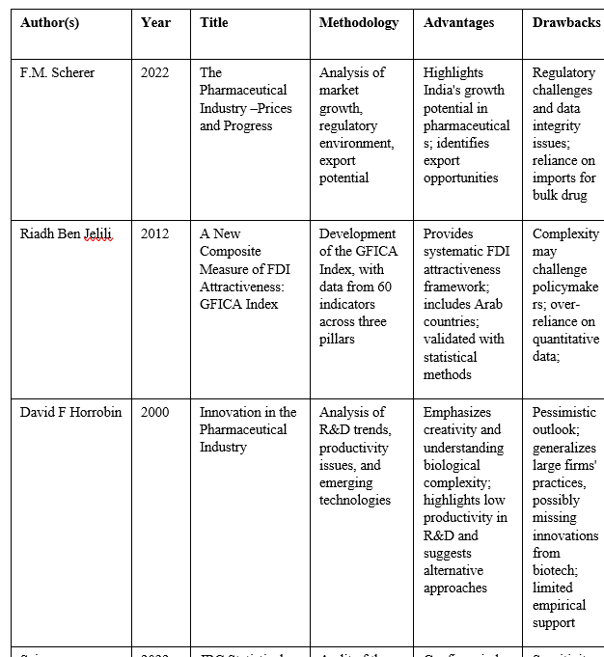
Literature Review
Notes:
Literature Review Slide Content:
Title: Literature Review
Introduction:
The concept of the Relative Attractiveness Index (RAI) provides a framework for evaluating the attractiveness of investments across various markets, including the pharmaceutical sector.
The pharmaceutical industry presents unique challenges due to its reliance on R&D investments, regulatory hurdles, and long product lifecycles.
Key Research Findings:
US7882001: Graphical System for Determining Investment Attractiveness
Strengths: Multi-factor evaluation using financial and growth indicators.
Application in Pharma: Aids in comparing peer companies based on risk and growth metrics.
Drawbacks: Complexity in interpretation and reliance on quantitative data alone.
ssrn_id3540484: Modeling Investment Attractiveness Using Entropy
Strengths: Predicts market instability using mathematical measures.
Application in Pharma: Evaluates risk and stability in volatile market conditions like the COVID-19 pandemic.
Drawbacks: Primarily uses historical data; qualitative factors like regulation and innovation potential are not integrated.
Paper18: Comparative Analysis Pre/Post-COVID-19
Strengths: Combines statistical and fractal methods to assess financial instruments, including those in pharma.
Drawbacks: Limited inclusion of qualitative factors like drug pipelines and patents.
Pharma Quality (1-s2.0-S1319016413001114)
Strengths: Reviews global pharma quality standards and highlights quality management practices like Six Sigma.
Application: Highlights quality as a competitive advantage in pharma, important for attracting investment.
Drawbacks: Few case studies on real-world implementation.
Conclusion:
The literature on the Relative Attractiveness Index indicates its valuable role in evaluating pharmaceutical market investments by balancing quantitative and qualitative factors. However, methodologies like those using entropy analysis and fractal dynamics can benefit from incorporating more forward-looking factors like innovation potential and regulatory changes.

Slide 6
Existing method Drawback
The existing methods for calculating the Relative Attractiveness Index (RAI) in the pharmaceutical industry have several drawbacks, as highlighted in the literature. Here are some key limitations:
Limited Focus on Emerging Trends
Generalization of Findings
Data Availability and Quality
Complexity of Market Dynamics
Subjectivity in Weighting Factors
Lack of Empirical Validation
Resource-Intensive Research
These drawbacks highlight the need for continuous improvement and adaptation of RAI methodologies to ensure they remain relevant and effective in guiding investment decisions in the pharmaceutical industry.
Notes:
The existing methods for calculating the Relative Attractiveness Index (RAI) in the pharmaceutical industry have several drawbacks, as highlighted in the literature. Here are some key limitations:
1. **Limited Focus on Emerging Trends**: Many existing methodologies primarily review established guidelines and practices, potentially overlooking newer trends and innovations in pharmaceutical quality management that could be relevant to the RAI [T2]. This can result in an incomplete assessment of market attractiveness.
2. **Generalization of Findings**: The findings derived from current RAI methodologies may not account for the specific contexts of different pharmaceutical companies or regions. This generalization can limit the applicability of the recommendations and insights provided by the RAI, making it less effective for targeted investment strategies [T2].
3. **Data Availability and Quality**: The effectiveness of the RAI is heavily dependent on the availability and quality of data used in its calculation. Inconsistent or incomplete data can lead to inaccurate assessments of market attractiveness, which may misguide investors [T4].
4. **Complexity of Market Dynamics**: The pharmaceutical industry is influenced by a multitude of factors, including regulatory changes, market volatility, and competitive pressures. Existing methods may struggle to adequately capture the complexity of these dynamics, leading to oversimplified evaluations [T1].
5. **Subjectivity in Weighting Factors**: The process of assigning weights to different factors in the RAI calculation can be subjective. Different stakeholders may prioritize various attributes differently, which can lead to inconsistencies in the RAI results and affect decision-making [T6].
6. **Lack of Empirical Validation**: There is a call for more empirical studies to validate the effectiveness of the methodologies used in calculating the RAI. Without robust validation, the reliability of the RAI as a decision-making tool remains uncertain [T2].
7. **Resource-Intensive Research**: The shift towards biologics and new chemical entities (NCEs) requires substantial investment and longer development timelines, which may pose financial risks for companies, especially smaller firms. Existing methods may not adequately address these financial implications in their assessments [T4].
These drawbacks highlight the need for continuous improvement and adaptation of RAI methodologies to ensure they remain relevant and effective in guiding investment decisions in the pharmaceutical industry.

Slide 7
Proposed Method
The proposed methods in the literature to overcome some of the drawbacks associated with existing Relative Attractiveness Index (RAI) methodologies include the following:
Incorporation of Emerging Trends
Usage of Real Time Data
Inclusion of Qualitative Factors
Objective Weighting of Factors
Empirical Validation
Dynamic and Adaptive Models
By implementing these proposed methods, the RAI can be enhanced to provide a more comprehensive and accurate assessment of investment opportunities in the pharmaceutical sector, addressing many of the limitations identified in existing methodologies.
Notes:
The proposed methods in the literature to overcome some of the drawbacks associated with existing Relative Attractiveness Index (RAI) methodologies include the following:
1. **Incorporation of Emerging Trends**: The literature suggests that future RAI methodologies should integrate newer trends and innovations in pharmaceutical quality management. This would ensure that the RAI remains relevant and reflective of the current market dynamics, rather than relying solely on established practices [T2].
2. **Context-Specific Analysis**: To address the generalization of findings, the proposed methods emphasize the importance of conducting context-specific analyses. This involves tailoring the RAI calculations to account for the unique characteristics of different pharmaceutical companies or regional markets, thereby enhancing the applicability of the index [T2].
3. **Enhanced Data Quality and Availability**: The literature advocates for improved data collection methods and the use of high-quality, reliable data inputs. This would help mitigate the risks associated with poor data quality, leading to more accurate assessments of market attractiveness [T4].
4. **Inclusion of Qualitative Factors**: To capture the complexity of market dynamics, the proposed methods recommend incorporating qualitative factors into the RAI calculations. This could involve assessing brand reputation, customer loyalty, and other non-quantitative attributes that influence market attractiveness [T3].
5. **Objective Weighting of Factors**: The literature suggests developing a more systematic approach to weighting the various factors considered in the RAI. This could involve using statistical techniques or expert consensus to reduce subjectivity and bias in the weighting process [T6].
6. **Empirical Validation**: There is a strong emphasis on the need for empirical studies to validate the effectiveness of the proposed RAI methodologies. Conducting real-world case studies and analyses would help establish the reliability and robustness of the RAI as a decision-making tool [T2].
7. **Dynamic and Adaptive Models**: The proposed methods advocate for the development of dynamic RAI models that can adapt to rapid changes in external conditions, such as technological advancements or shifts in regulatory environments. This would allow the RAI to remain relevant in a fast-evolving industry [T3].
By implementing these proposed methods, the RAI can be enhanced to provide a more comprehensive and accurate assessment of investment opportunities in the pharmaceutical sector, addressing many of the limitations identified in existing methodologies.

Slide 8
Objectives
To Define the Relative Attractiveness Index: Establish a clear understanding of the RAI, its components, and its significance in the context of the pharmaceutical industry.
To Examine Market Trends:This entails looking into the variables that affect market attractiveness, including market volatility, innovation trends, regulatory frameworks, and economic conditions. Analyzing the ways in which these elements combine to present investors with opportunities and difficulties.
To Evaluate Methodologies: Examine the methodologies used in calculating the RAI, including statistical and fractal analysis, and their applicability to the pharmaceutical sector.
To Identify Challenges and Opportunities: Highlight the challenges faced by the pharmaceutical industry, such as patent expirations, regulatory hurdles, and competition, while also identifying potential growth opportunities.
Fill up the Gaps in Current RAI Models: Fill Gaps in the areas like-Subjectivity in weighing factors, Complex market dynamics, underrepresentation of emerging markets
To Foster Collaboration: Emphasize the importance of collaboration between industry and academia to enhance innovation and drive growth within the pharmaceutical sector.

Slide 9
Methodology/Modules
To make the project of developing a Relative Attractiveness Index (RAI) for the pharmaceutical industry possible, the following methodologies and modules are proposed:
Data Collection Module
Data Processing and Analysis Module
Model Development Module
Visualization Module
Validation and Testing Module
Deployment and Maintenance Module
By implementing these methodologies and modules, the project aims to create a robust and user-friendly RAI tool that can effectively guide investment decisions in the pharmaceutical industry.
Notes:
To make the project of developing a Relative Attractiveness Index (RAI) for the pharmaceutical industry possible, the following methodologies and modules are proposed:
1. **Data Collection Module**:
- **Market-Level Data**: Gather relevant data on various therapeutic areas, including market size, growth rates, R&D investments, and competitive intensity. This can involve using APIs (e.g., World Bank API) for real-time economic data and aggregating information from company reports and industry publications [T6].
- **Primary Research**: Conduct surveys or interviews to collect customer/patient preference data and insights on physician prescribing habits, which are crucial for understanding market dynamics [T1].
2. **Data Processing and Analysis Module**:
- **Statistical Analysis**: Use statistical tools and software (e.g., Python with Pandas or R) to analyze the collected data, identify trends, and calculate the RAI based on predefined criteria and weights [T5].
- **Normalization Techniques**: Implement normalization methods to ensure that data from different sources and scales can be compared effectively [T5].
3. **Model Development Module**:
- **RAI Calculation Model**: Develop a mathematical model to calculate the RAI by weighting various factors such as market size, growth potential, profitability, and regulatory environment. This model should allow for flexibility in adjusting weights based on stakeholder input [T4].
- **Dynamic Modeling**: Create a dynamic model that can adapt to changes in market conditions, allowing for real-time updates to the RAI as new data becomes available [T3].
4. **Visualization Module**:
- **User Interface Development**: Use frontend technologies (e.g., HTML/CSS, JavaScript, React.js or Vue.js) to create an interactive user interface that allows users to visualize the RAI results through charts, graphs, and maps [T5].
- **Data Visualization Tools**: Implement libraries like Chart.js or D3.js to render visual representations of the RAI and other relevant data, making it easier for users to interpret the results [T5].
5. **Validation and Testing Module**:
- **Empirical Validation**: Conduct case studies and real-world testing of the RAI model to validate its effectiveness and reliability. This may involve comparing the RAI results with actual market performance and investment outcomes [T2].
- **Feedback Mechanism**: Establish a feedback loop with stakeholders to refine the model based on user experiences and insights, ensuring continuous improvement [T2].
6. **Deployment and Maintenance Module**:
- **Web Application Deployment**: Deploy the web application on a suitable platform, ensuring it is accessible to users and can handle data requests efficiently [T5].
- **Ongoing Maintenance**: Plan for regular updates and maintenance of the application to incorporate new data, improve functionalities, and address any technical issues that arise [T6].
By implementing these methodologies and modules, the project aims to create a robust and user-friendly RAI tool that can effectively guide investment decisions in the pharmaceutical industry.

Slide 10
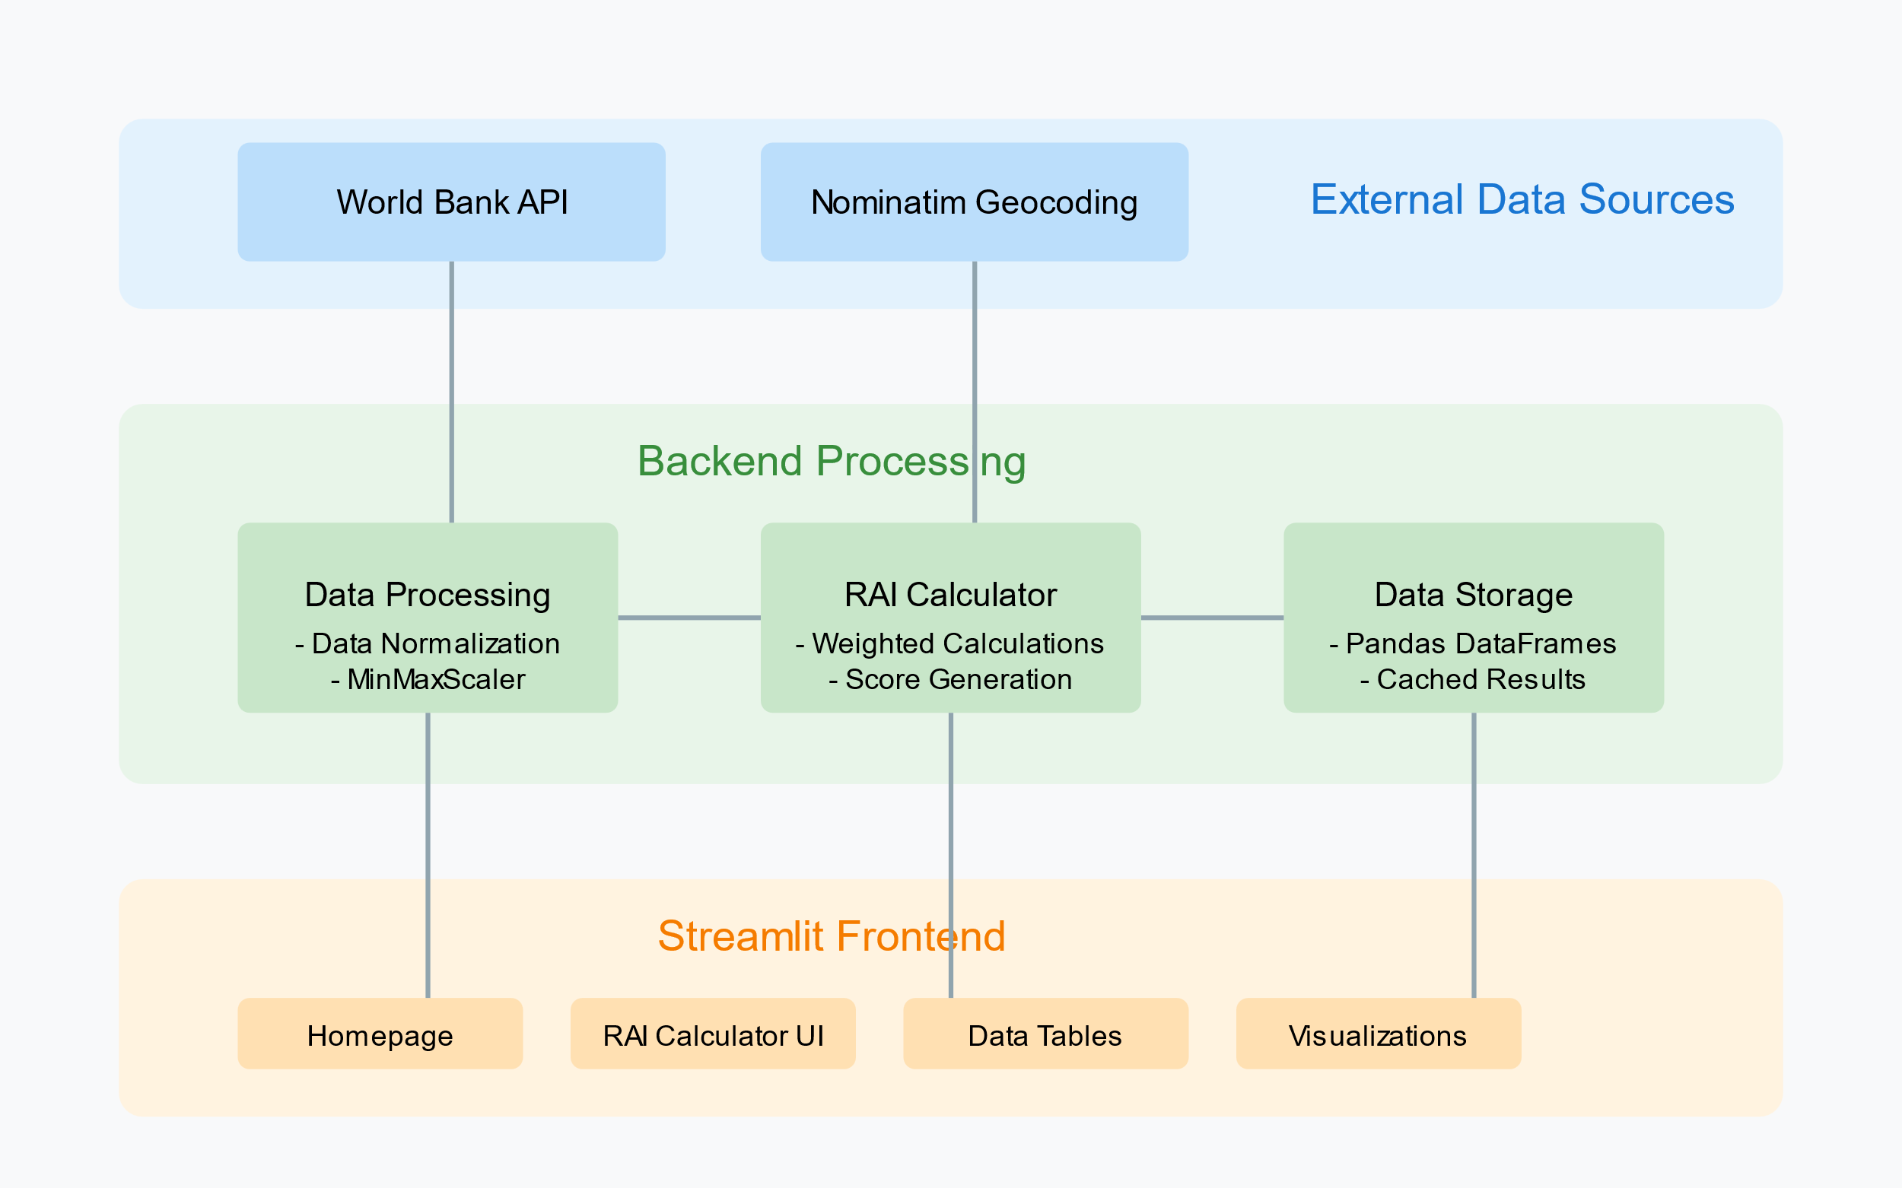
Architecture
Notes:
+---------------------+
| Data Collection |
| |
| +---------------+ |
| | World Bank | |
| | API | |
| +---------------+ |
| | |
| | |
| +---------------+ |
| | IMF API | |
| +---------------+ |
| | |
| | |
| +---------------+ |
| | Pharma DBs | |
| | (Evaluate, | |
| | IQVIA) | |
| +---------------+ |
| | |
| | |
| +---------------+ |
| | Web Scraping | |
| +---------------+ |
+---------|-----------+
|
v
+---------------------+
| Data Processing |
| |
| +---------------+ |
| | Python | |
| | (Pandas, | |
| | NumPy) | |
| +---------------+ |
| | |
| | |
| +---------------+ |
| | ML Models | |
| +---------------+ |
+---------|-----------+
|
v
+---------------------+
| Data Presentation |
| |
| +---------------+ |
| | Frontend UI | |
| | (React.js / | |
| | Vue.js) | |
| +---------------+ |
| | |
| | |
| +---------------+ |
| | Visualization | |
| | (Chart.js, | |
| | D3.js, | |
| | Maps API) | |
| +---------------+ |
+---------------------+

Slide 11
Hardware/software components
To successfully execute the project of developing a Relative Attractiveness Index (RAI) for the pharmaceutical industry, the following components are required:
Data Sources : API-Worldbank
Data Processing and Analysis Software:Scikit and data visualisation modules
Frontend Development Tools : Streamlit (Python module)
Backend Development Tools :Python (Pandas,wbdata,scikit learn)
Data Visualization Tools : Folium, Geopy,Plotly
Deployment and Hosting : Streamlit Cloud
Project Management Tools :Github,Visual Studio Code
By assembling these components, the project can be effectively developed, deployed, and maintained, ensuring a comprehensive and user-friendly RAI tool for the pharmaceutical industry.
Notes:
To successfully execute the project of developing a Relative Attractiveness Index (RAI) for the pharmaceutical industry, the following components are required:
1. **Data Sources**:
- **APIs**: Access to reliable APIs such as the World Bank API, International Monetary Fund (IMF) API, and other economic data sources for real-time data collection [T2].
- **Market Research Reports**: Subscription to industry reports from firms like IQVIA or EvaluatePharma for detailed market insights [T3].
- **Company Financials**: Access to financial statements and reports from pharmaceutical companies to gather data on R&D investments and market performance [T4].
2. **Data Collection Tools**:
- **Web Scraping Tools**: Use of Python libraries like BeautifulSoup or Scrapy for gathering data from online sources when APIs are not available [T2].
- **Survey Tools**: Platforms for conducting surveys or interviews to collect primary data on customer preferences and physician habits [T4].
3. **Data Processing and Analysis Software**:
- **Programming Languages**: Proficiency in Python or R for data analysis, statistical modeling, and calculations of the RAI [T5].
- **Data Analysis Libraries**: Use of libraries such as Pandas and NumPy in Python for data manipulation and analysis [T5].
4. **Database Management**:
- **Relational Database**: MySQL or PostgreSQL for storing structured data related to countries, economic factors, and historical RAI data [T6].
- **NoSQL Database (Optional)**: MongoDB for handling complex data structures, especially if detailed country profiles are involved [T6].
5. **Frontend Development Tools**:
- **HTML/CSS**: For structuring and styling the web application [T6].
- **JavaScript Frameworks**: React.js or Vue.js for building an interactive user interface that allows users to visualize and interact with the RAI data [T5].
6. **Backend Development Tools**:
- **Node.js with Express**: For creating APIs that serve data to the frontend and handle data processing requests [T6].
- **Python (Optional)**: For handling data-intensive tasks and complex calculations, especially if using data analysis libraries [T6].
7. **Data Visualization Tools**:
- **Charting Libraries**: Chart.js or D3.js for rendering visual representations of the RAI and other relevant data [T5].
- **Mapping Libraries**: Leaflet.js or Google Maps API for displaying geographic data and comparisons visually [T6].
8. **Testing and Validation Tools**:
- **Statistical Software**: Tools for conducting empirical validation and testing the RAI model against real-world data [T2].
- **User Feedback Mechanisms**: Systems for collecting user feedback to refine and improve the RAI model and application [T2].
9. **Deployment and Hosting**:
- **Web Hosting Services**: A reliable hosting platform to deploy the web application, ensuring it is accessible to users [T5].
- **Version Control Systems**: Tools like Git for managing code changes and collaboration among team members [T6].
10. **Project Management Tools**:
- **Collaboration Platforms**: Tools like Trello, Asana, or Jira for project management and tracking progress [T6].
- **Documentation Tools**: Platforms for maintaining project documentation, such as Confluence or Google Docs [T6].
By assembling these components, the project can be effectively developed, deployed, and maintained, ensuring a comprehensive and user-friendly RAI tool for the pharmaceutical industry.

Slide 12
Timeline of Project
Phase | Duration | Tasks
Phase1:Project planning | 0.5 month | Week 1: Define project scope, objectives, and deliverables. Week 2: Identify key stakeholders and gather requirements. Week 2: Develop a project plan and timeline.
Phase2:Data collection | 1 month | Week 3-4: Identify and access data sources (APIs, market reports, etc.). Week 5: Conduct primary research (surveys/interviews) to gather customer/patient preference data. Week 6: Collect and aggregate secondary data
Phase3:Data Analysis | 1 month | Week 7-8: Clean and preprocess the collected data (data cleaning, normalization). Week 9: Develop the RAI calculation model. Week 10: Validate the model with historical data
Phase4:Devolpment | 1 month | Week 11: Design the UI/UX for the web application. Week 12: Develop the frontend using HTML/CSS and JavaScript frameworks. Week 13: Develop the backend. Week 14: Integrate data visualization tools. Validational UI
Phase5: Testing and Validation | 0.5 month | Week 15: Conduct functional testing. Week 16: Perform UAT with stakeholders. Week 17: Address issues or bugs identified during testing.

Slide 13
Outcomes
The Relative Attractiveness Index of World Markets (RAI) project serves as a comprehensive tool for evaluating global markets based on various economic, social, and political factors. It aims to address the complexities involved in investment decision-making by providing a data-driven, objective, and user-friendly platform. The project has made several significant contributions and yielded important outcomes that can transform how investors and businesses assess market opportunities and risks such as:
Development of a Robust and Data-Driven RAI Tool
Automation of Investment Decision-Making
Enhanced Risk Management
Visualization and User-Centric Design
Strategic Insights and Market Opportunities
Contribution to Sustainable Development Goals (SDGs)
Notes:
A simple user interface to make consumers understand the rai and customization of factors

Slide 14
Conclusion
The Relative Attractiveness Index of World Markets (RAI) project has successfully developed an advanced, data-driven tool that enables investors, businesses, and market analysts to assess and compare the attractiveness of global markets based on a comprehensive set of economic, political, and regulatory factors. The primary objective of the project was to create a tool that not only improves the accuracy and objectivity of market evaluations but also supports strategic decision-making through real-time data and predictive analytics. The results of this project demonstrate that the RAI tool effectively addresses several critical challenges faced by traditional market evaluation methods. By integrating quantitative indicators such as GDP, inflation rates, and market growth, with qualitative factors like political stability and regulatory frameworks, the RAI provides a holistic view of market dynamics. This multidimensional approach enhances the precision of market rankings and offers investors the insights necessary for making informed investment decisions in diverse global markets
Notes:
### **Conclusion Slide Content:**
---
**Title: Conclusion**
1. **Comprehensive Analysis Tool**
- The **Relative Attractiveness Index (RAI)** provides a systematic, data-driven approach for evaluating global markets in the pharmaceutical industry.
- By integrating both **quantitative factors** (economic data, market size, growth rates) and **qualitative factors** (regulatory environment, innovation potential), the RAI offers a holistic view of market attractiveness.
2. **AI-Driven Insights**
- The use of **AI and machine learning tools** (Python, statistical models) in processing large datasets ensures accuracy and scalability in analyzing multiple countries and companies.
- This enables real-time decision-making, helping investors, businesses, and policymakers make informed decisions.
3. **Interactive Visualization**
- The platform provides a user-friendly interface with **interactive charts and maps**, making it easy to compare and visualize market and company-level data across different regions.
- Tools like **Chart.js** and **Leaflet.js** enhance data presentation, offering valuable insights for business expansion and investment strategies.
4. **Future Prospects**
- As global pharmaceutical markets evolve, the RAI can continuously adapt by incorporating **emerging trends** such as **biotechnology advancements**, regulatory shifts, and market dynamics, keeping stakeholders informed with up-to-date insights.
---
**Takeaway**:
The RAI project stands as a robust tool for evaluating the **pharmaceutical industry's global attractiveness**, combining **AI-driven data analysis** with interactive visualization to support better decision-making in a complex market environment.

Slide 15
Github Link
saralaufeyson/CSE55-Relative-Attractiveness-Index-of-World-Markets: Relative Attractiveness Index of World Markets-PCCS126

Slide 16
References
DiMasi, J. A. (1991): Cost of innovation in the pharmaceutical industry. Conducts a cost analysis of pharmaceutical R&D with sensitivity analysis on success rates and costs.
Haleem, A., Kumar, S., & Khalil, M. (2013): Quality in the pharmaceutical industry – A literature review. Reviews 102 studies on pharmaceutical quality standards, including WHO, FDA, EU, and ICH guidelines.
Haleem, A., Kumar, S., & Khalil, M. (2020): Challenges in pharmaceutical industry decision-making: A review. Explores subjectivity in factor weighting and potential biases affecting decision-making processes.
Horrobin, D. F. (2000): Innovation in the pharmaceutical industry. Analyzes R&D trends, productivity challenges, and the role of emerging technologies in the pharmaceutical sector.
Horrobin, D. F. (2019): Emerging trends in biotechnology and medicine development. Highlights the importance of advancements in market studies and their impact on the pharmaceutical industry.
Jelili, R. B. (2012): A new composite measure of FDI attractiveness: GFICA index. Develops the GFICA Index using data from 60 indicators across three pillars to measure FDI attractiveness.
JRC (2022): JRC Statistical Audit of the 2022 Global Attractiveness Index. Focuses on auditing the Global Attractiveness Index for statistical reliability and validity.
Maksyshko, N. (2021): Comparative analysis of financial instrument investment attractiveness. Applies statistical and fractal analysis, including the Hurst exponent, to evaluate time series predictability pre- and post-COVID-19.
Nahum, A. (2004): Graphical system for determining relative attractiveness of investment. Proposes a multi-factor investment scoring model using radar chart visualization for comparative assessments.
Scherer, F. M. (2022): The pharmaceutical industry – Prices and progress. Analyzes market growth, the regulatory environment, and export potential in the pharmaceutical sector.
Notes:
Its there in the word file i sent u bruh

Slide 17

Project work mapping with SDG
This project demonstrates a strong commitment to advancing sustainable development by aligning with several United Nations Sustainable Development Goals (SDGs). The following SDGs are addressed through the project's objectives and outcomes:
SDG3:Good Health and Well-Being
SDG8:Decent Work and Economic Growth
SDG9:Industry Innovation and Infrastructure
SDG10: Reduced Inequalities
SDG17:Partnerships for the Goals
Notes:
8th one,9thone

Slide 18
Thank You

